Slide 1

AUTOMOTIVE INTERNSHIP AROBS
Project by Deac Dan Cristian
Coordinators: Bogdan, Ahmad, Laurentiu, Tudor, Mihai and Alin.

Slide 2

Structure
Weeks 1-2: Introduction to embedded systems in automotive.
Week 2: Presentations from embedded team about what it means to be an embedded software developer.
Week 3: Tool acquisition and climate control module design (Git Extensions, VScode, YouTrack, Draw.io).
Week 3->6: Implementation of the climate control module in the project.

Slide 3

Concepts learned
Automotive in general
Functional Safety – ISO 26262
V-Cycle
ASIL
AUTOSAR
Makefile
MISRA C
Microcontrollers
Communication Protocols
Embedded Software Development

Slide 4
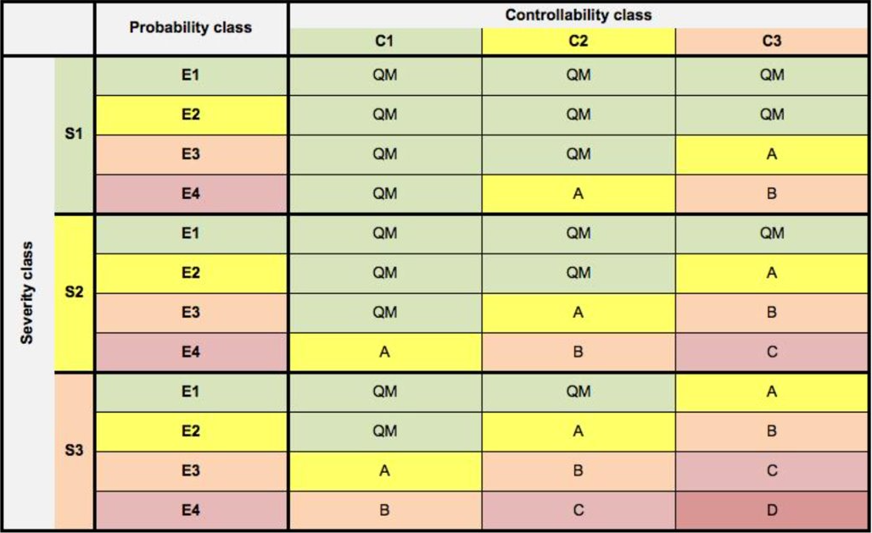
ISO 26262 standard defines functional safety as the “absence of unreasonable risk due to hazards caused by malfunctioning behavior of electrical/electronic systems”.
Reason for standard :
Establish various safety requirements -> mitigate risks to acceptable levels.
Smoothly manage and track safety requirements.
Ensure standard safety procedures in delivered products.
ASIL (Automotive safety integrity level) : "risk classification scheme for defining the safety requirements"
Risk parameters:
Severity, Exposure and Controllability

Slide 5
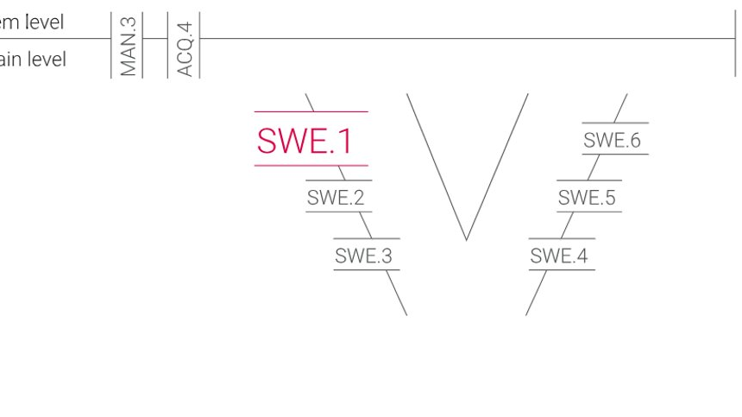
Requirements
Testing
V-Cycle
SWE1: Software Requirements Analysis
SWE2: Software Architectural Design
SWE3: Software Detailed Design and Unit Construction
SWE4: Unit Verification
SWE5: Integration and Integration Test
SWE6: Qualification Test

Slide 6
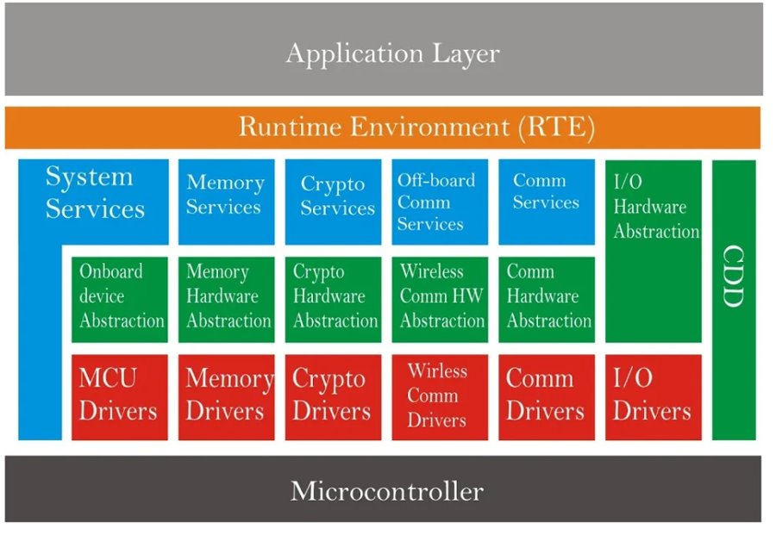
AUTOSAR
Scalability
Transferability
Availability
Safety requirements
Sustainable use of natural resources
maintainability

Slide 7
Purpose
Learning what it meaning to be an embedded software developer in automotive.
Simulation of real tasks that are assigned to embedded developers in automotive projects.
Learn development on large projects, respecting V-cycle and Agile workflow.
Learn to write industry quality code, with an accent on writing descriptive comments.

Slide 8
Outcome
Understanding what it means to work on a real automotive project.
Understanding and respecting the V-Cycle in software development.
Source control using git with git Extensions.
Understanding the importance of a well written documentation and code comments.
The importance of writing requirements and tests.
Understanding the importance and how to write a Makefile for large projects.
Understanding how to draw detailed design diagrams.

Slide 9
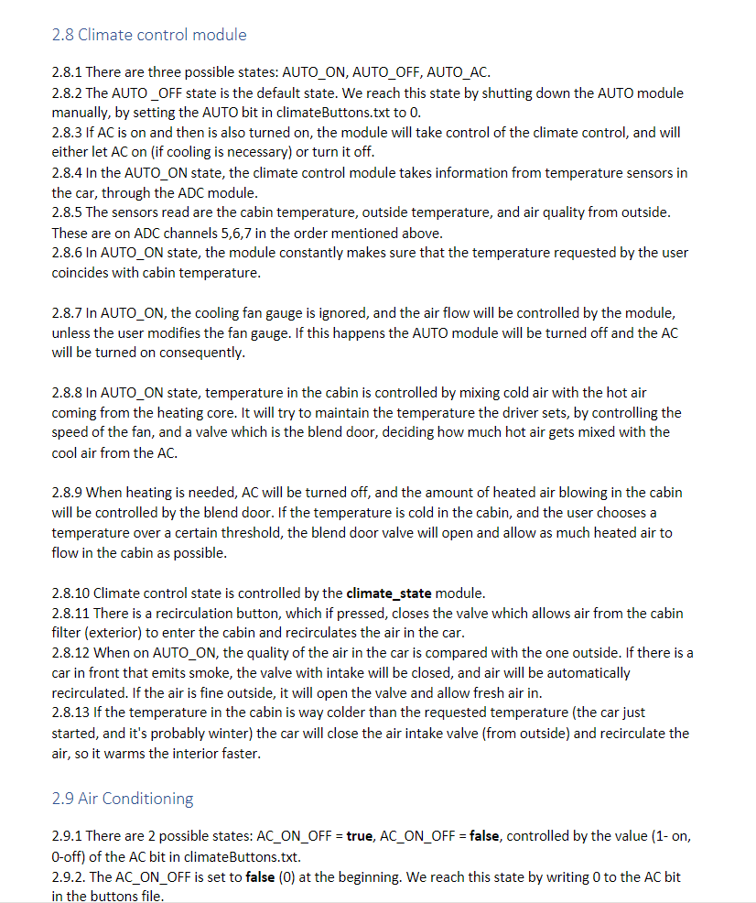
Software Requirements
Requirements were written at the beginning but updated throughout the project development, when other features appear.

Slide 10
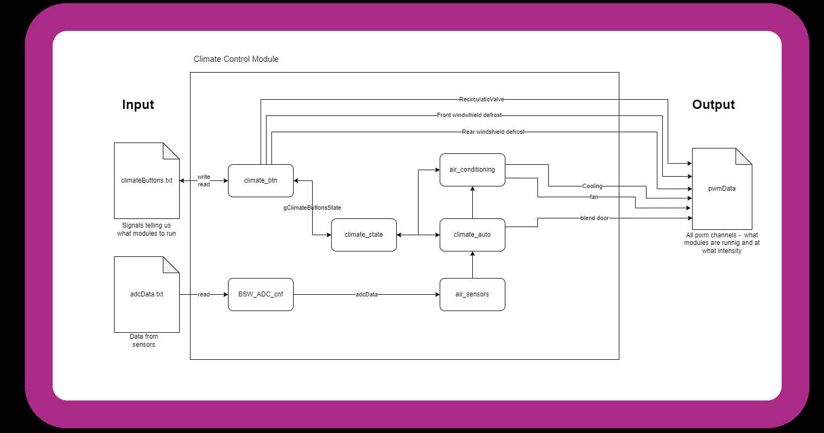
Architecture

Slide 11
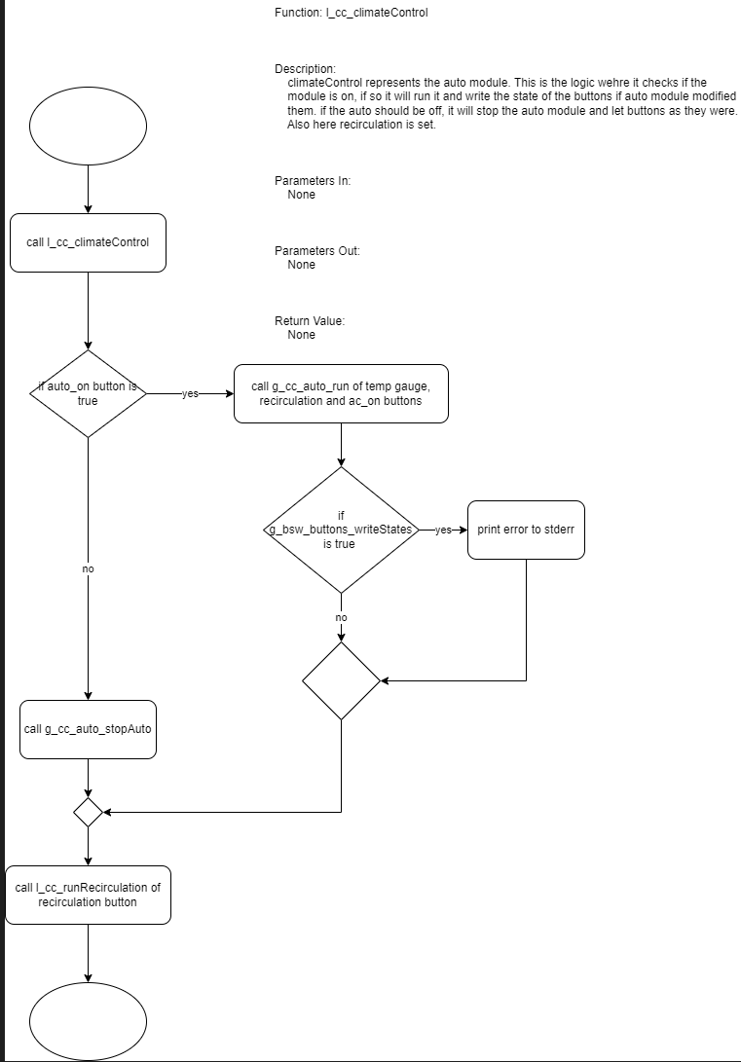
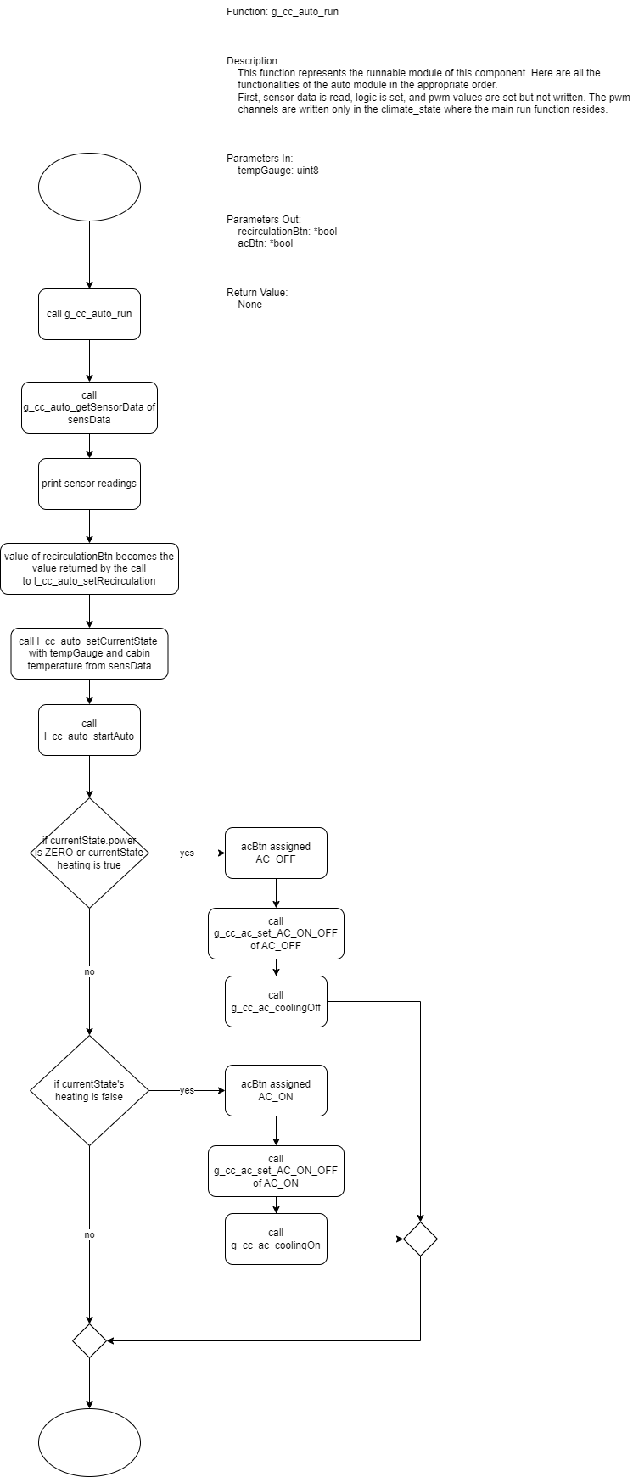
Detailed Design
Describes how the function works.
This will also be updated as the function is implemented and changes appear.

Slide 12
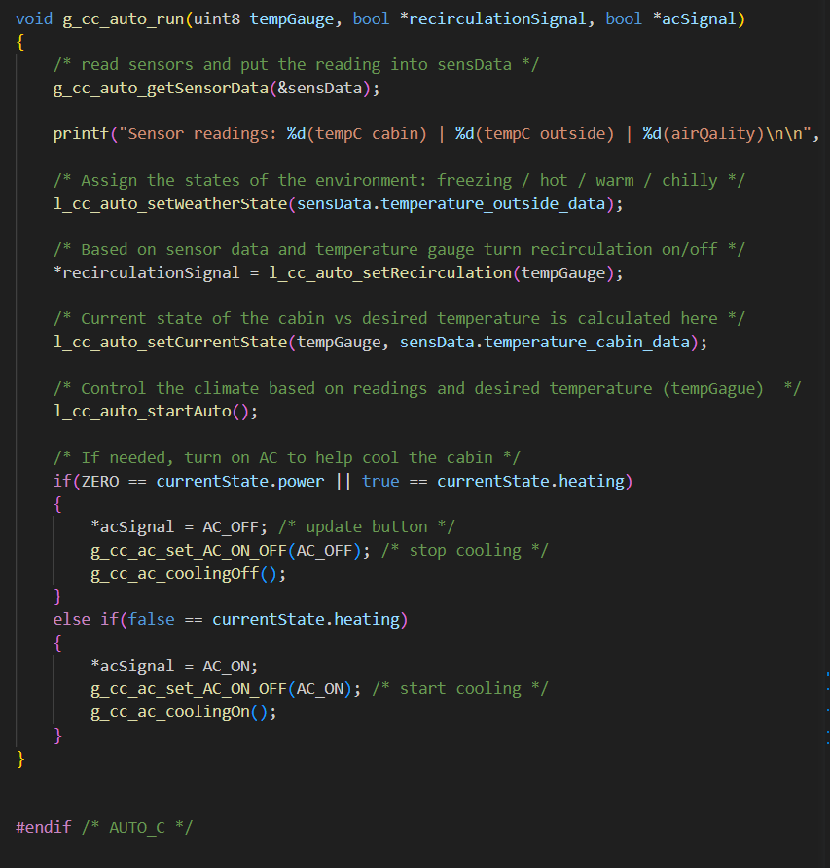
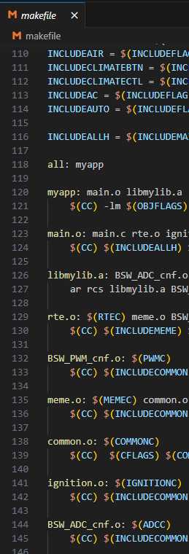
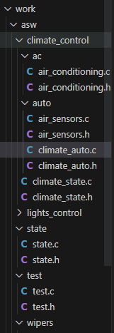
C O D E

Slide 13
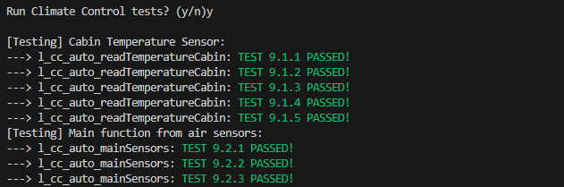
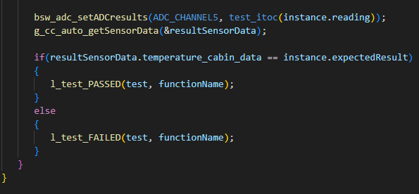
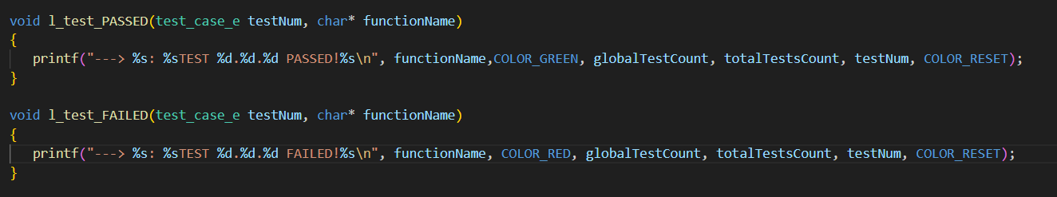
Testing

Slide 14
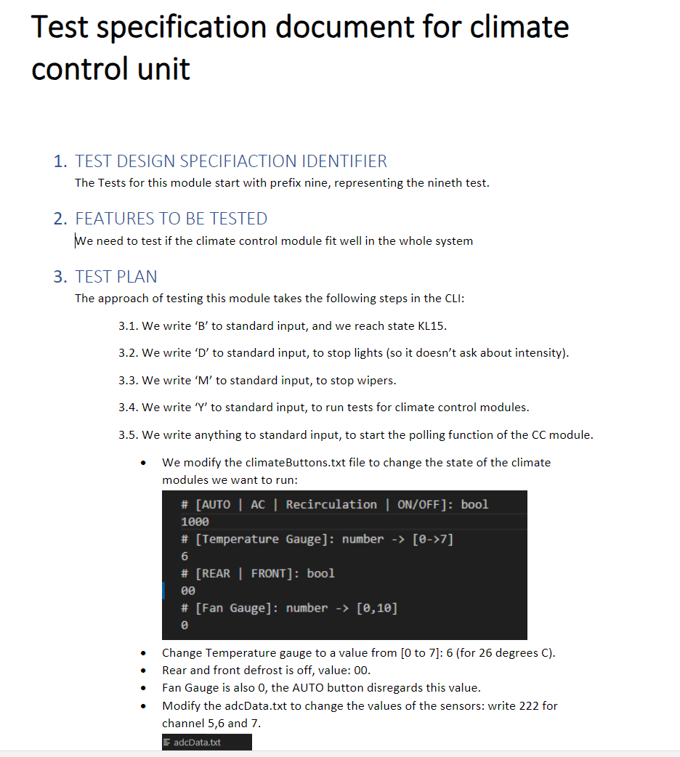
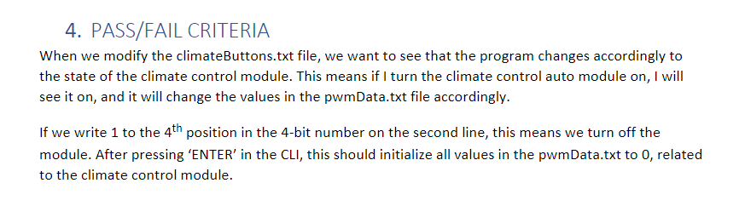
Test Specification Document
Test design specification identifier
Feature to be tested
Test Plan
Pass/Fail criteria

Slide 15
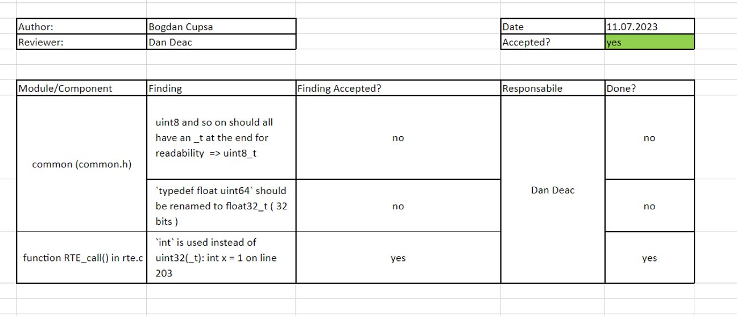
Review

Slide 16
Technology Stack
GitHub and Git Extensions – Source Control / Version Control
YouTrack – Agile
VS code – IDE
Draw.io - Detailed Design

Slide 17
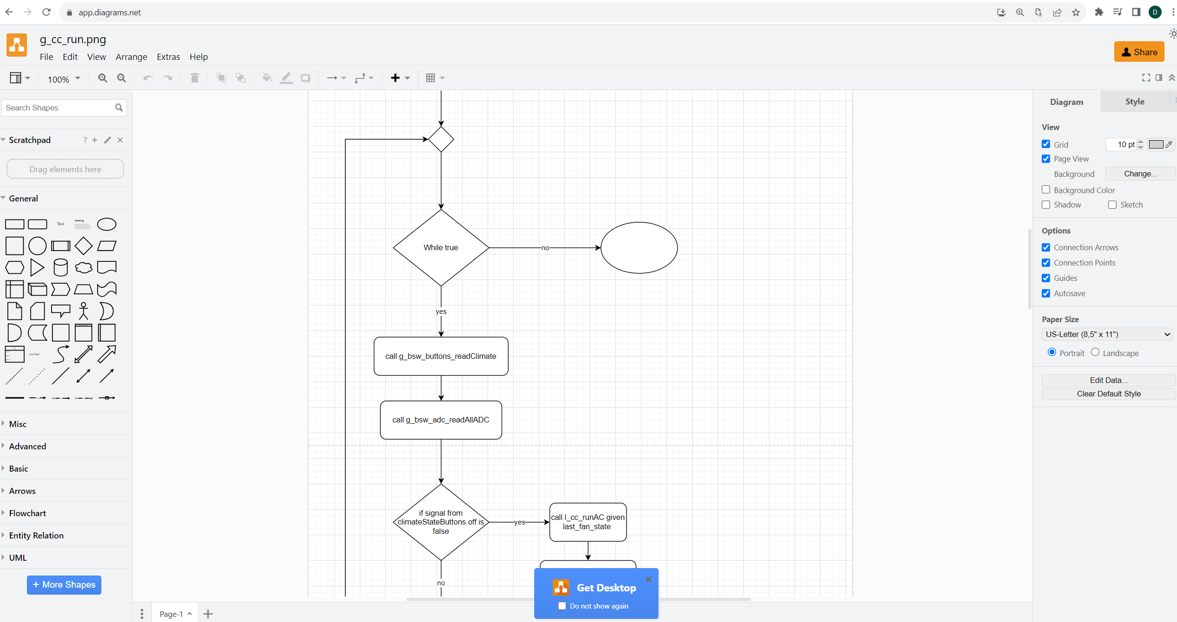
Draw.io

Slide 18
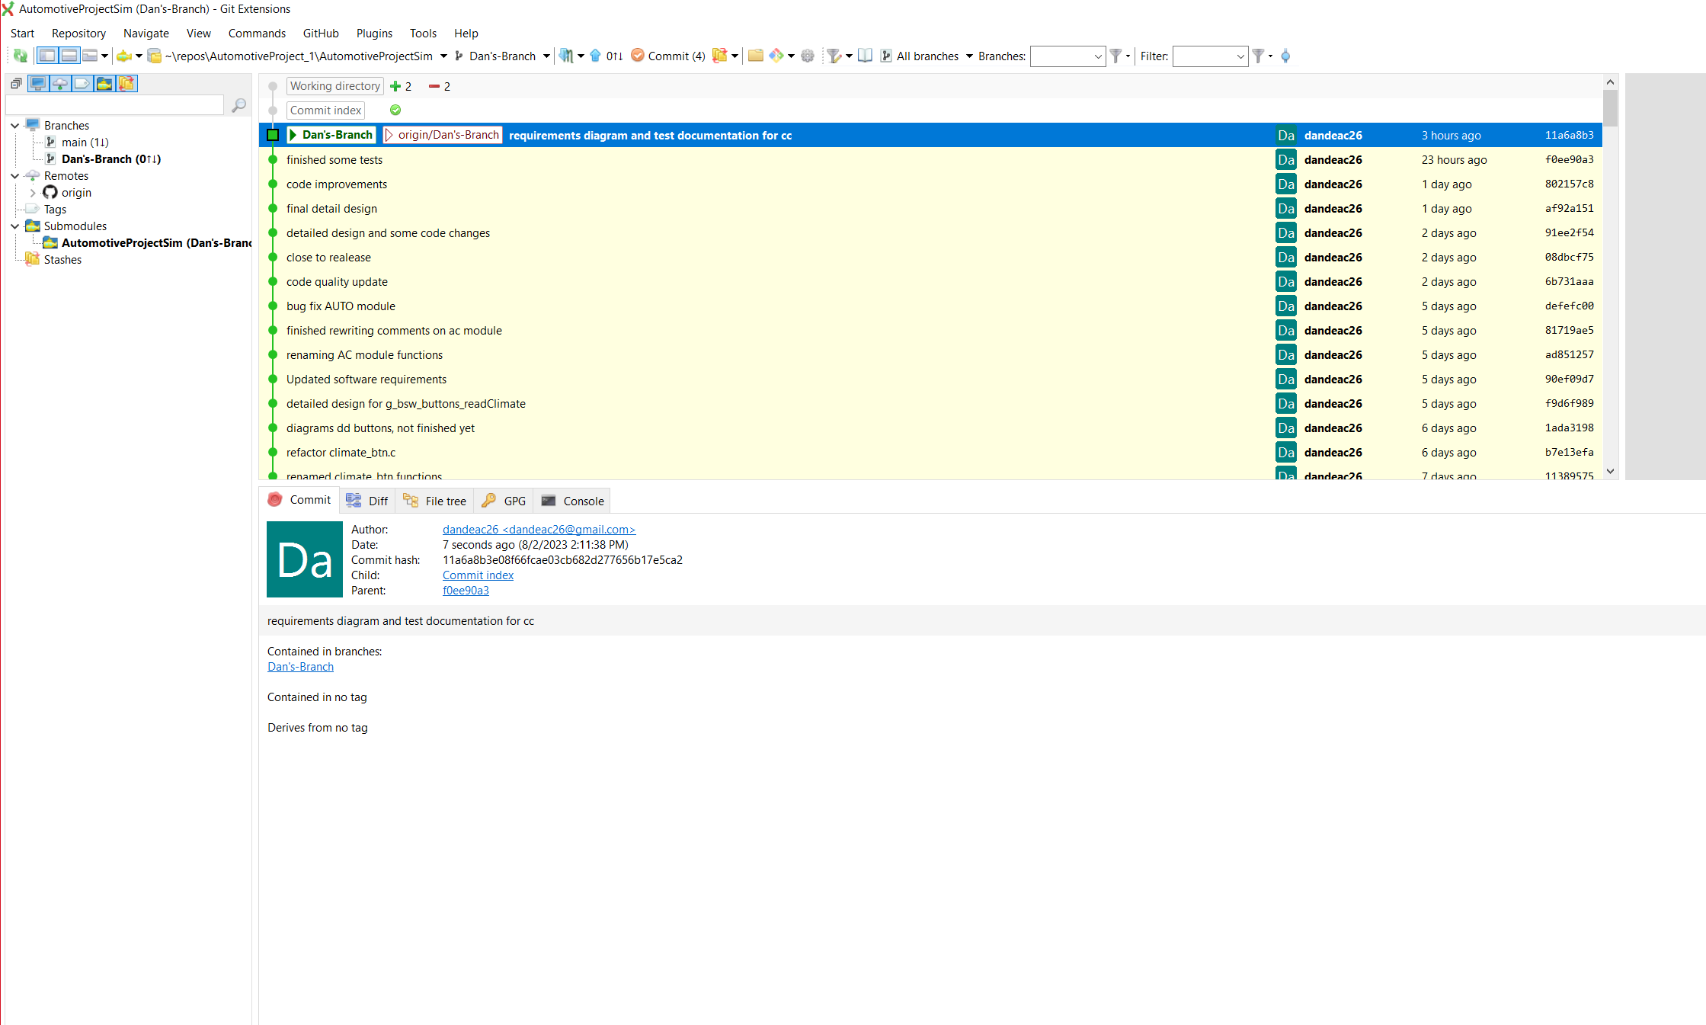
Git Extensions

Slide 19
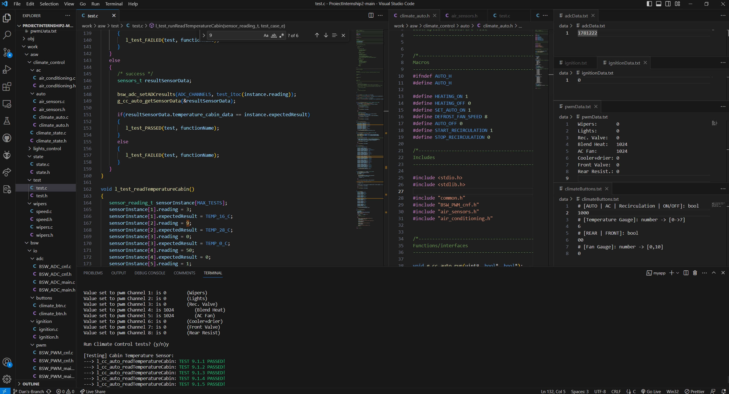
VS code

Slide 20
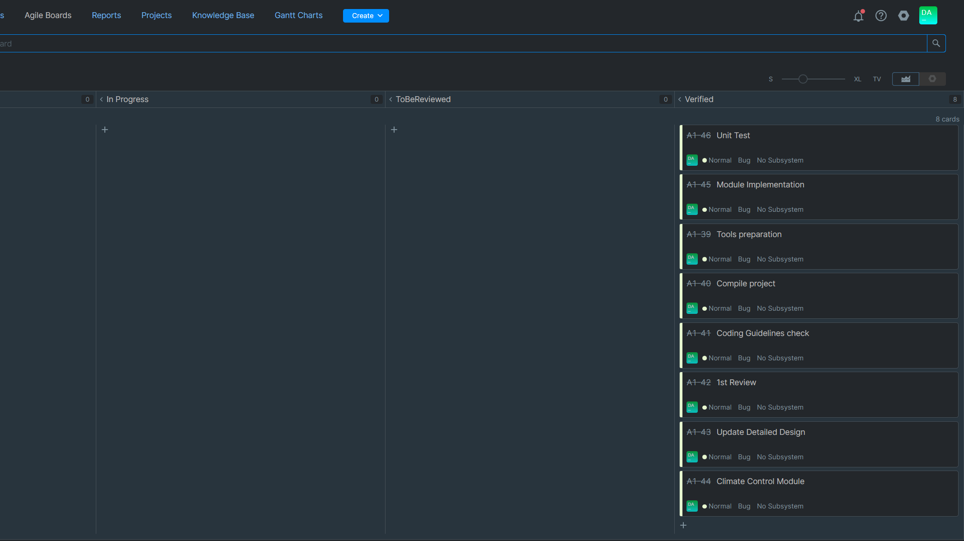
Agile - YouTrack
Agile : project management framework
-> sprints

Slide 21
Thank you!

